Slide 1
GEOG-G489/589 Python Programming
Instructor: Natasha MacBean
Intro to Cartopy

Slide 2
Introduction to plotting Geographic maps with Cartopy
Python users previously used Basemap (https://matplotlib.org/basemap/) to plot georeferenced maps.
However, the CartoPy project has taken over Basemap and therefore it will soon be discontinued (see announcement here: https://matplotlib.org/basemap/users/intro.html#cartopy-new-management-and-eol-announcement).
New Python users are therefore recommended to learn CartoPy: https://scitools.org.uk/cartopy/docs/latest/.
CartoPy makes use of PROJ.4, NumPy and Shapely libraries and works with the matplotlib plotting library.
The CartoPy project is still updating the library with features from Basemap - so if there's some feature you'd like to plot that can't yet be done with CartoPy, you may want to learn Basemap as well.

Slide 3
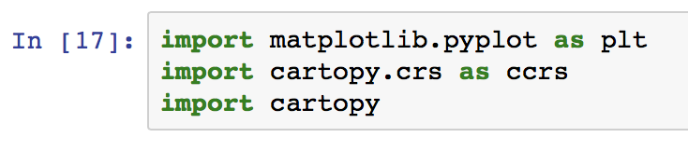
Introduction to plotting Geographic maps with Cartopy
For now, we are going to learn some basic plotting functions with CartoPy. Geospatial surfaces are plotted onto 2D surfaces using projections and associated coordinate reference systems.
For more information on coordinate reference systems, see here: https://docs.qgis.org/testing/en/docs/gentle_gis_introduction/coordinate_reference_systems.html
If you’re interested in GIS python applications I would check out the last two modules of the DataCamp course “Visualizing Geospatial Data in Python”: https://www.datacamp.com/courses/visualizing-geospatial-data-in-python
We deal with projections in CartoPy by loading the Cartopy coordinate reference systems using the following line of code:
import cartopy.crs as ccrs
import cartopy

Slide 4
Steps for setting up a Cartopy map
First, we initialize a matplotlib figure
plt.figure(figsize=(10,5))
Then use the CartoPy crs to add a projection
ax = plt.axes(projection=ccrs.PlateCarree())
This command creates an axes subclass → more specifically in this case, it is a cartopy.mpl.geoaxes.GeoAxes.
This means it uses cartopy axes methods for drawing maps and overrides some of matplotlib's existing axes methods in the process.
Note, you can achieve the same thing just with the following commands:
fig = plt.figure(figsize=(10,5)) ax = fig.add_subplot(1, 1, 1, projection=ccrs.PlateCarree())
Note also that you also do not need to specify the figure size. I’ve done that here to make the plot a little larger than the default…

Slide 5
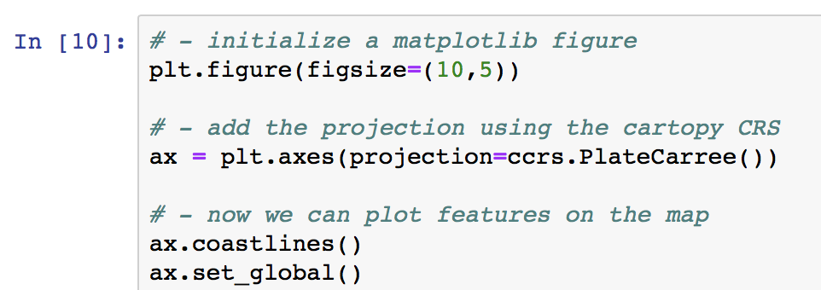
Steps for setting up a Cartopy map
We can now use this geoaxes subclass to draw some features, such as coastlines, using the command:
ax.coastlines()
We can also use the command ax.set_global() to ensure the map has a global extent, even if the data we plot doesn't fill an entire global map.
Here is a list of all the available geoaxes methods: https://scitools.org.uk/cartopy/docs/v0.13/matplotlib/geoaxes.html. We will cover some of them today.

Slide 6
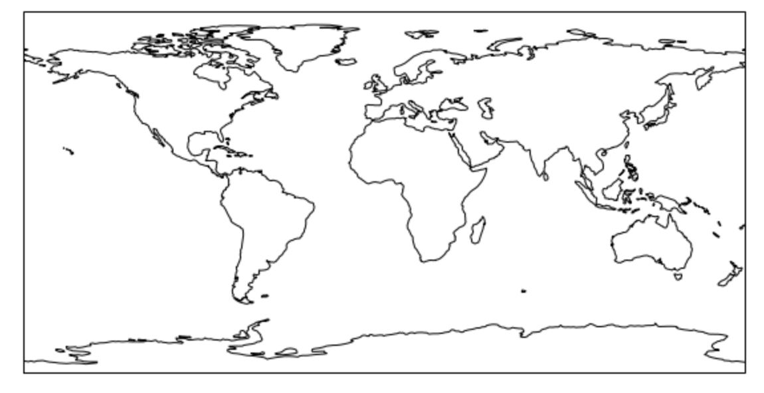
Setting up a global Cartopy map

Slide 7
Different projections
The Plate Carree projection is just one of the projections available in CartoPy. See a full list here: https://scitools.org.uk/cartopy/docs/latest/crs/projections.html
Plate Carree, Robinson, Mollweide and Equal Earth are popular in for plotting maps in the global earth system modeling communities.
Notice that each of the different projections has a different number of keyword arguments, depending on the complexity of the map.
One of the most common keywords is "central_longitude" which is the longitude running vertically in the center of the map. This defaults to 0.0 (i.e. a longitude of zero).
Mini in-class exercise
In a new jupyter notebook, practice setting up a Cartopy map with the code we’ve just learned.
Once you have created one map using the code above, create a new map but change the line of code starting: ax = plt.axes(projection... so the central longitude of the map is the longitude of Bloomington (which is 86.5 degrees W, so -86.5).

Slide 8
Other geoaxes methods
i) ax.stock_img() → adds a stock earth terrain and biome image to the map. Clearly we don't want to use that when we are plotting data, but it is interesting to know!
ii) ax.gridlines(draw_labels=True) → draws gridlines at certain latitudes and longitudes on the plot, but no labels. If you add the draw_labels=True keyword you will also get the latitude and longitude labels.
You can also change the default location of the axes gridlines for both the x and y axes using the keywords xlocs (for longitudes) and ylocs (for latitudes):
ax.gridlines(draw_labels=True, xlocs=[-120,-60,0,60,120], ylocs=[-60,-30,0,30,60])

Slide 9
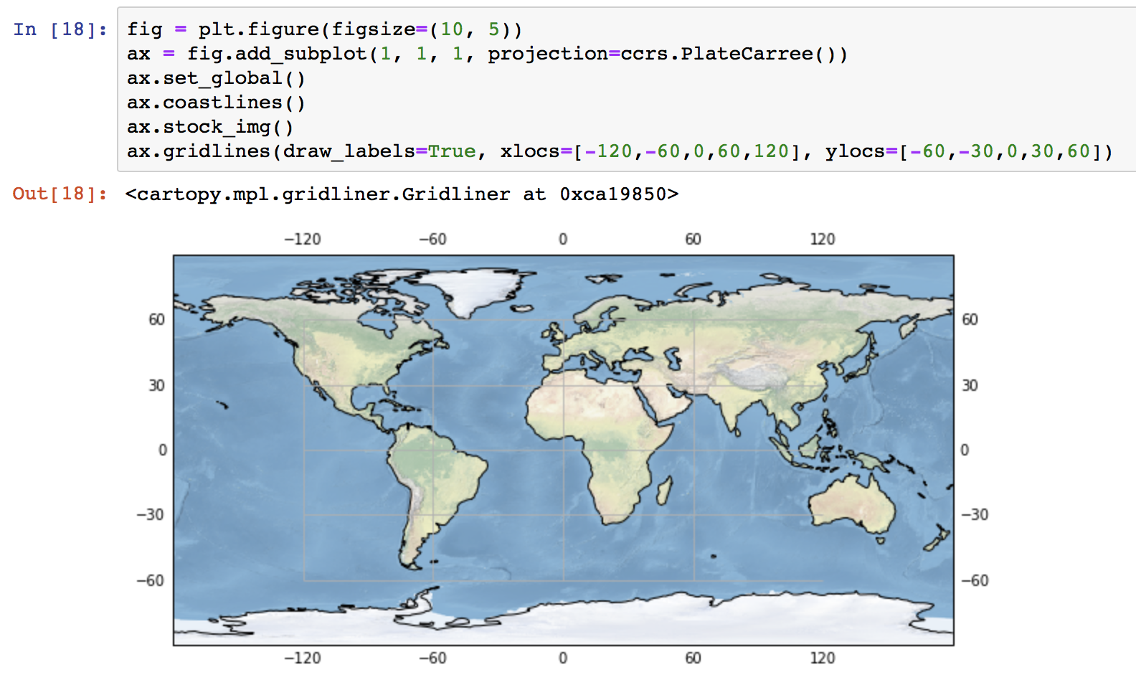
Other geoaxes methods

Slide 10
Other geoaxes methods
iii) ax.set_extent() → is the opposite of ax.set_global() and can be used to zoom into a particular region to define a regional map. The method takes one argument "extents" which is a list or tuple containing [xmin, xmax, ymin, ymax], i.e.
extents = [-130, -65, 24, 50.5]
ax.set_extent(extents)
...would give a map of the continguous US.
However, you will then also need to re-set the central longitude, otherwise your map will not be centered correctly.
Therefore when you initialize your map you should set ccrs.PlateCarree(central_longitude=np.mean(extents[:2])
Note for the US the albers equal area projection is often used, which has both central_longitude and central_latitude as keyword arguments.

Slide 11
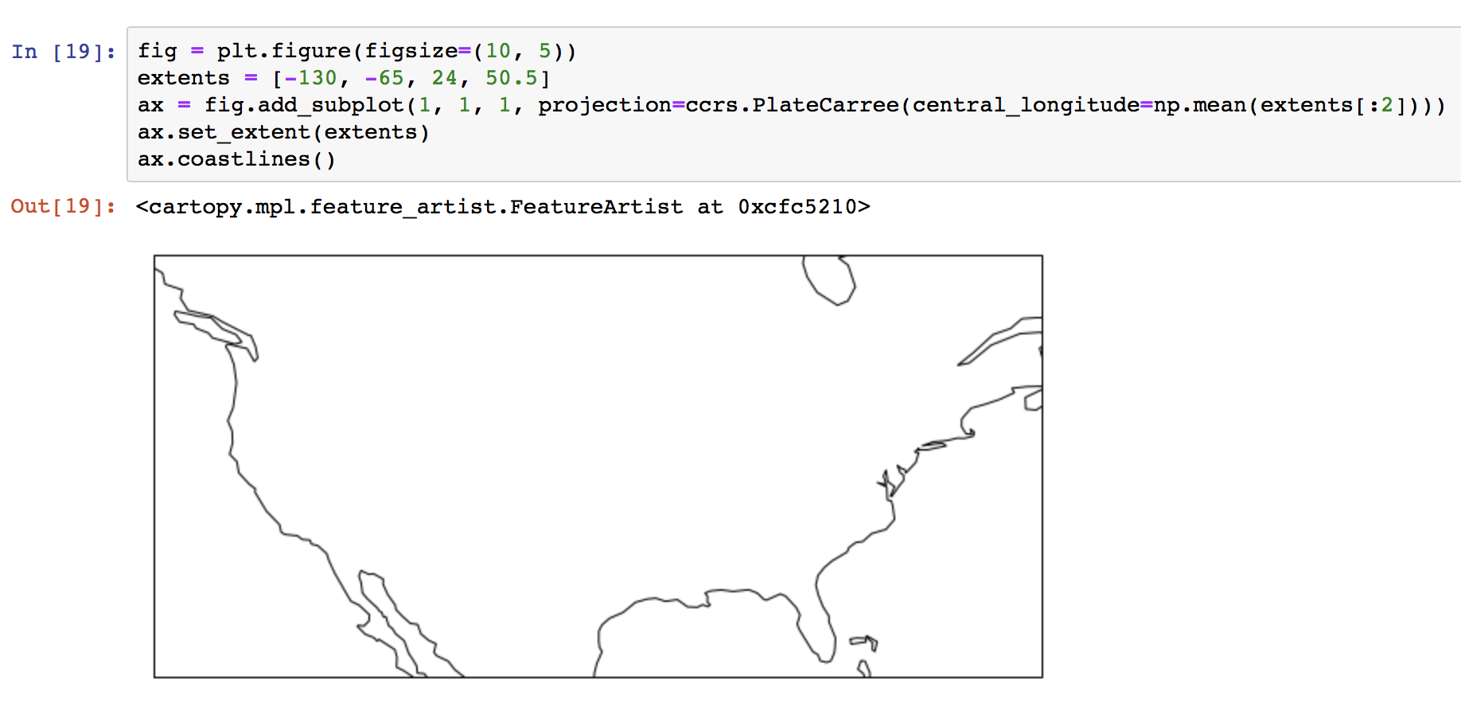
Other geoaxes methods

Slide 12
Other geoaxes methods
iv) ax.add_feature(FEATURE) → adds certain points, lines or polygons features to the map.
This page explains more about the features interface: https://scitools.org.uk/cartopy/docs/v0.14/matplotlib/feature_interface.html.
This can also be used to add vector features such as shapefiles. CartoPy has a number of pre-defined geographical features that can improve the visualization of your map and help to orient yourself in a particular location, including:
cartopy.feature.BORDERS
cartopy.feature.COASTLINE
cartopy.feature.LAKES
cartopy.feature.RIVERS
For example, if we were to plot the map of the North America with the set_extent(), we still wouldn't yet be able to see exactly where the border between the US and Canada or the border between the US and Mexico are. Therefore if we add the command:
ax.add_feature(cartopy.feature.BORDERS)
…our regional map of the contiguous US will become much clearer.

Slide 13
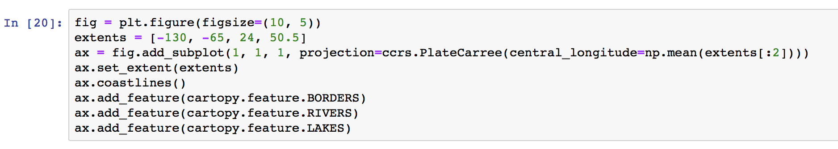
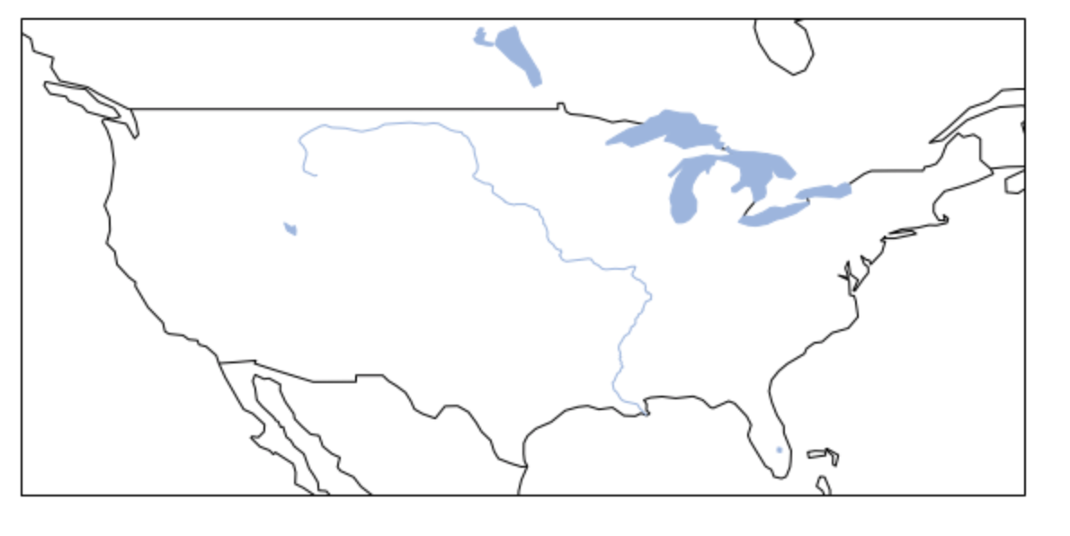
Other geoaxes methods
You can see that the RIVERS feature is fairly limited. If you want higher resolution features, CartoPy downloads shapefiles and creates these features automatically from the Natural Earth or NOAA GSHHS Databases. More information and links to the websites can be found on the main features page here: https://scitools.org.uk/cartopy/docs/v0.14/matplotlib/feature_interface.html#cartopy.feature.cartopy.feature.OCEAN

Slide 14
Final notes on geoaxes methods
Other geoaxes methods that you may find useful for your work include:
ax.imshow()
ax.add_raster()
If you're interested in plotting maps, I recommend you look through these methods carefully: https://scitools.org.uk/cartopy/docs/v0.13/matplotlib/geoaxes.html
You can also find out more by looking in the CartoPy Gallery: https://scitools.org.uk/cartopy/docs/latest/gallery/index.html
NOTE: we can find out more the projections and geosaxes methods using a ? directly after the command with no parentheses, e.g.
ccrs.PlateCarree?
ax.gridlines?

Slide 15
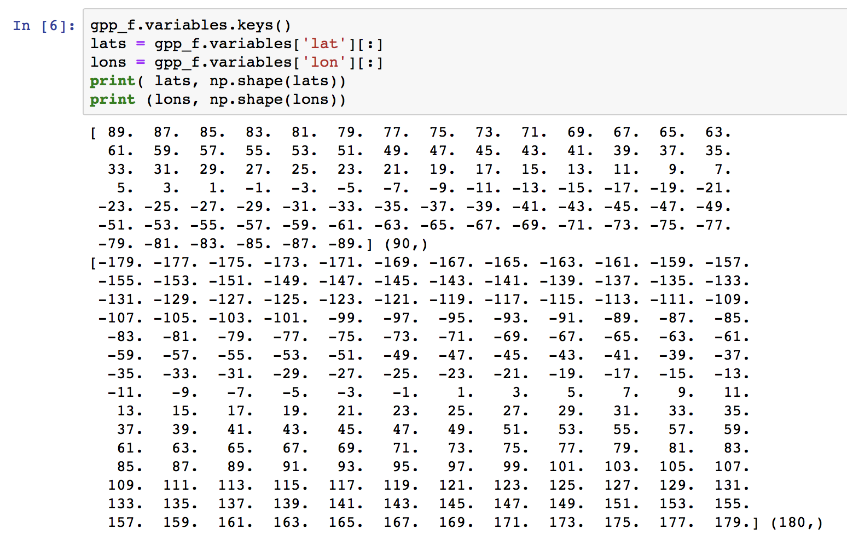
Adding data to the map → need coordinate information
Unlike using imshow(), when we’re plotting a geographic map we also need the coordinate information (i.e. latitudes and longitudes).
In the case of our netcdf file containing GPP, you will have noticed we have the lat and lon information in the file. If you don’t have it, you would have to create it.

Slide 16
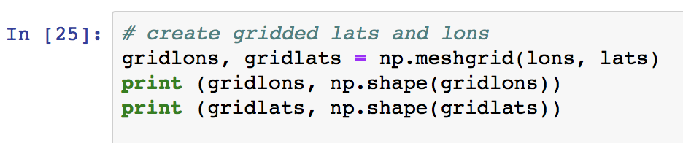
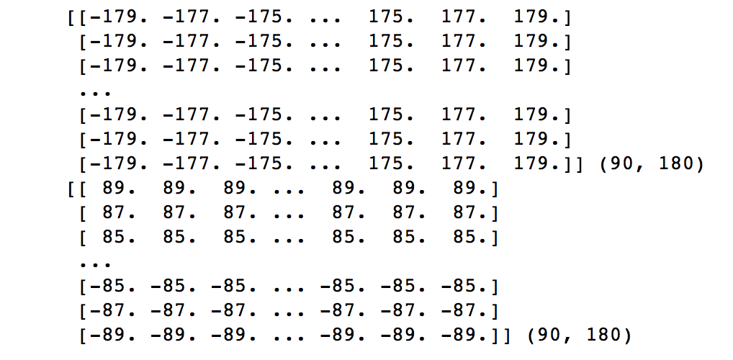
Creating 2d grids of lats and lons
In this case, lats and lons are just 1d arrays representing the range of latitude and longitudes in the grid (e.g. longitude ranges from -180 to 180 degrees).
To plot on a 2d map, we therefore need to create a 2d grids of these variables for plotting the 2d map.
For this, we use the command np.meshgrid() as follows:
gridlons, gridlats = np.meshgrid(lons, lats)
Arrays are now 2D, not 1D

Slide 17
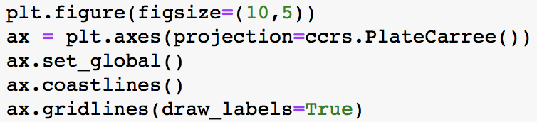
Set up figure as before

Slide 18
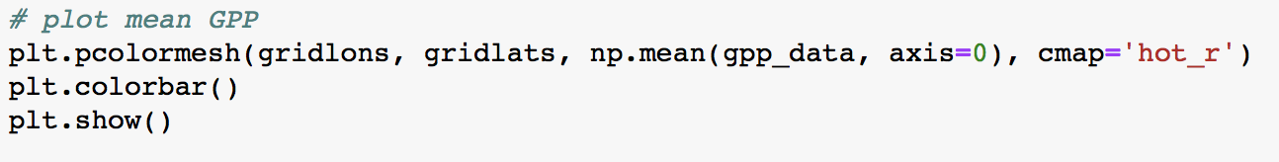
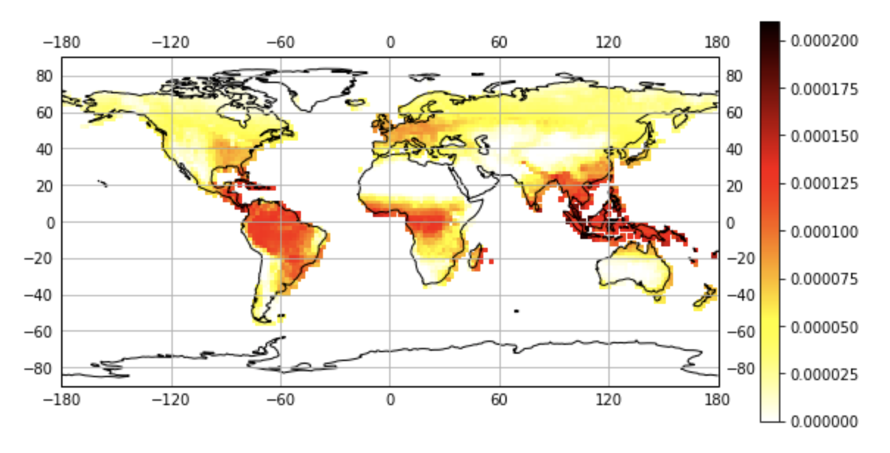
Add data using pcolormesh() with our gridlons and gridlats

Slide 19
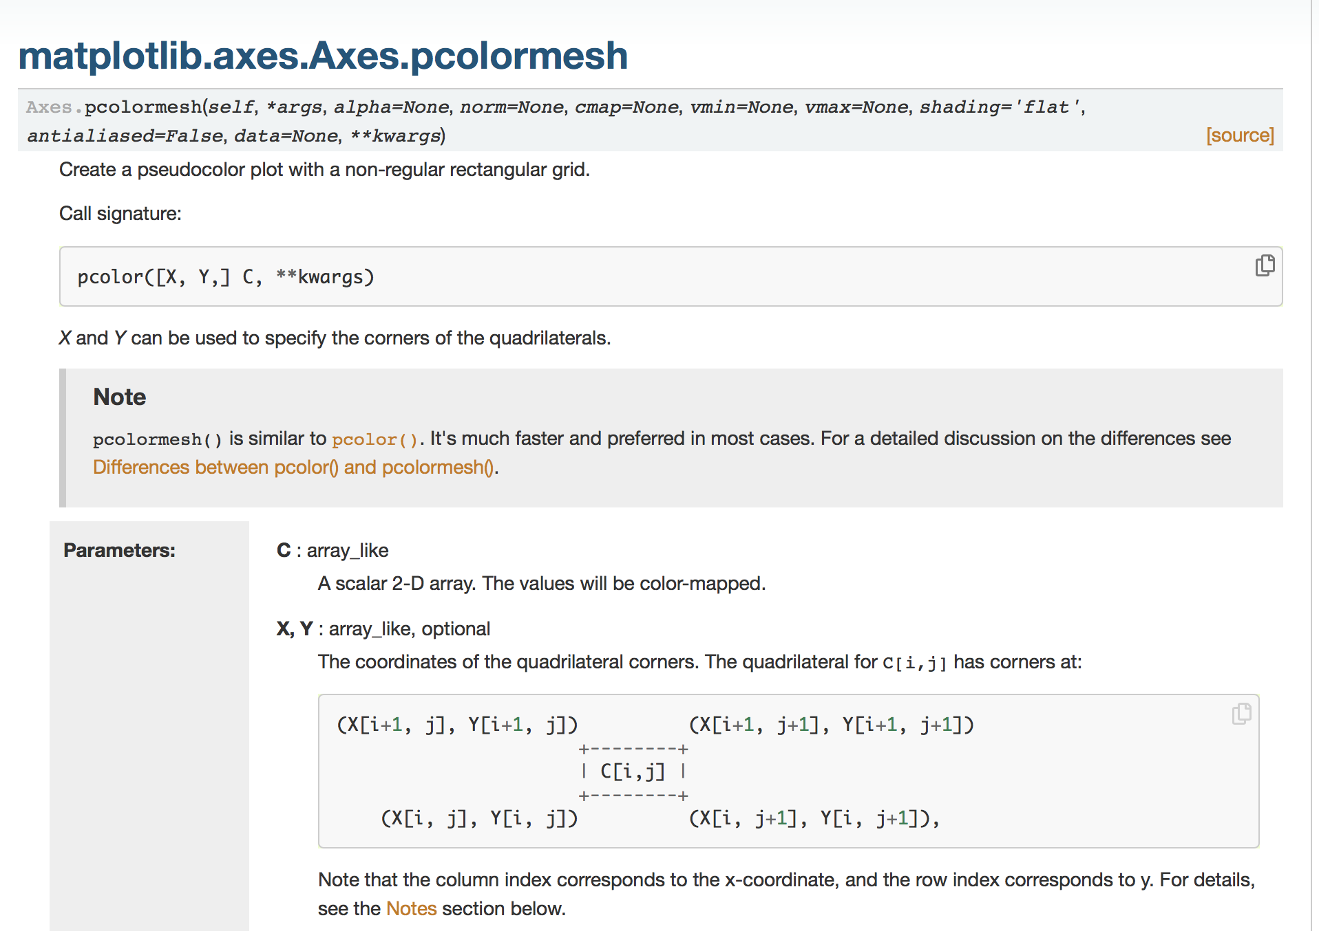
Add data using pcolormesh() with our gridlons and gridlats
https://matplotlib.org/api/_as_gen/matplotlib.axes.Axes.pcolormesh.html

Slide 20
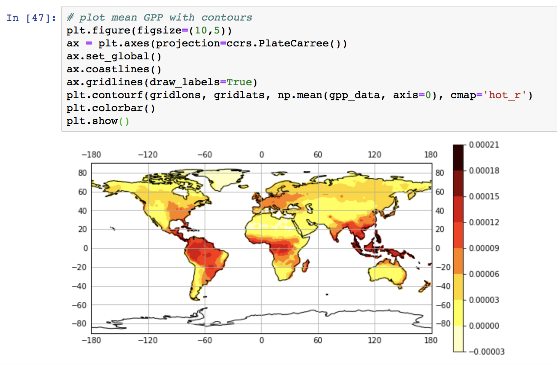
Adding data using contourf()
We can also use the matplotlib command:
plt.contourf()
with the same arguments as we used for plt.pcolormesh() to give us a contour plot that will interpolate (smoothe) the individual grid cells that we see in the plot above.

Slide 21
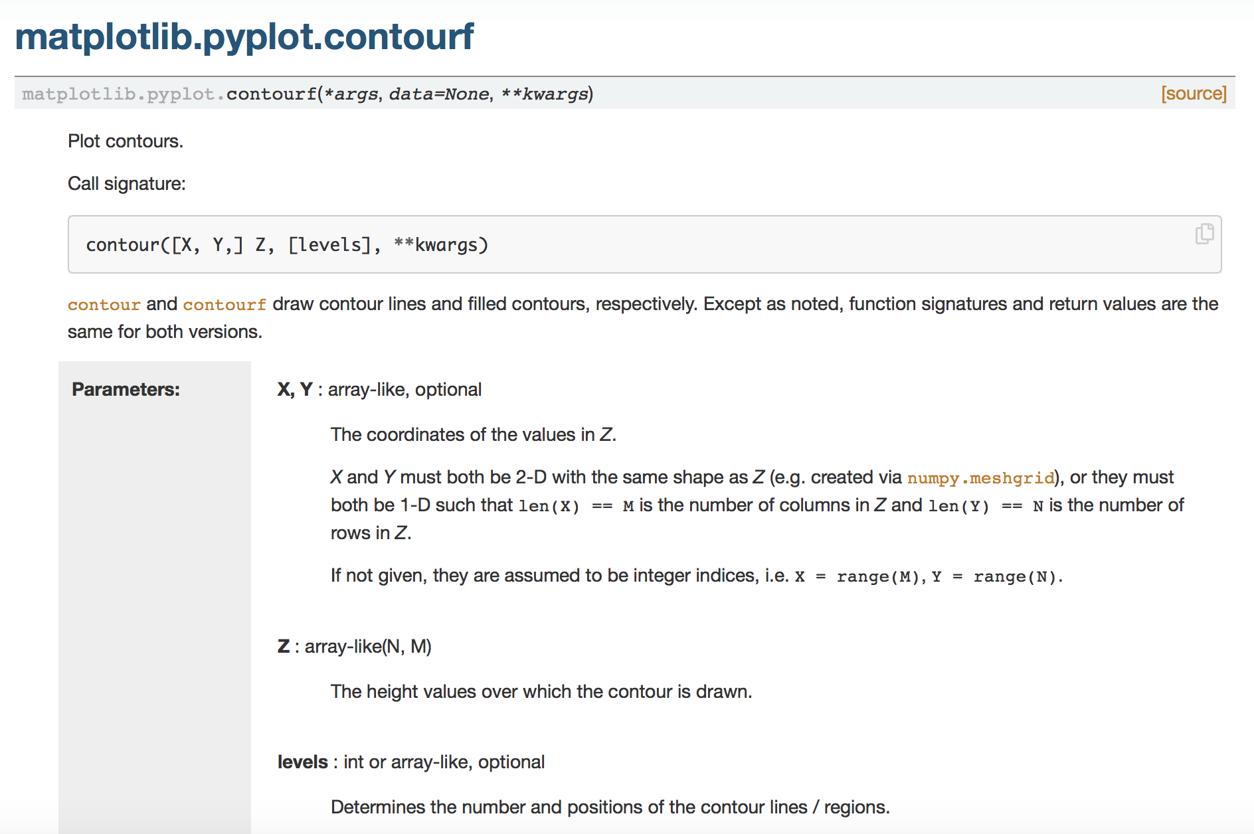
Adding data using contourf()
https://matplotlib.org/3.1.1/api/_as_gen/matplotlib.pyplot.contourf.html

Slide 22
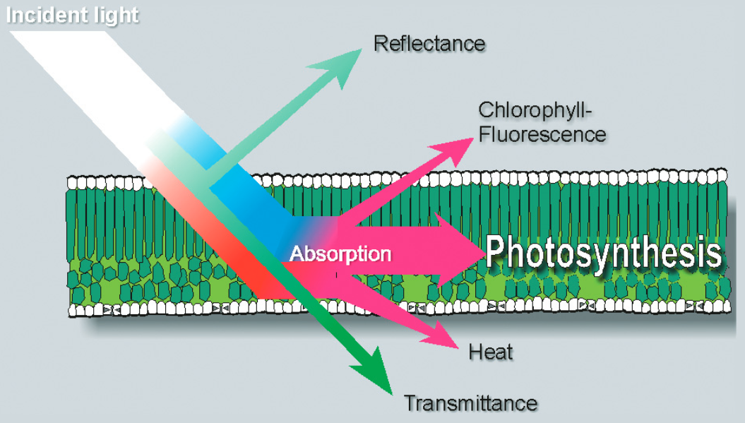
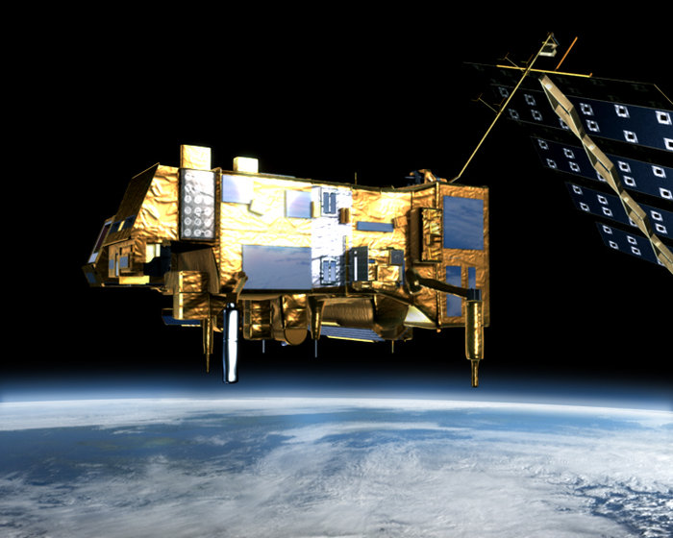
Today’s in-class exercise
In today’s assignment we’re going to visually compare spatial distributions of GPP to a satellite product of solar induced chlorophyll fluorescence.
SIF is a byproduct of photosynthesis; therefore, it should be a good proxy for GPP.
The SIF data were collected from the GOME-2 satellite (https://www.eumetsat.int/website/home/Satellites/CurrentSatellites/Metop/MetopDesign/GOME2/index.html).
In our analysis we will use the SIF to evaluate if the model GPP contains an accurate spatial representation of photosynthesis processes.

Slide 23
Today’s in-class exercise
The SIF data are in a different netcdf file called gome2_sif_monthly_2007-2011.nc
They have the same spatial and temporal resolution
Follow what we have learned in class over the past week or two to read in the GPP and SIF data and plot both datasets on two separate Cartopy maps with geospatial latitude and longitude coordinates on the x and y axes of the plot.
Write the logic (step-by-step) of the script you plan to write at the top in a markdown box
Then, answer the following questions in your Jupyter Notebook:
Do the spatial distributions of the mean GPP and mean SIF look similar, even though the range of each data is not the same?
In which region is plant productivity the highest (give latitude and longitude information)? Is this what we may expect?

Slide 24
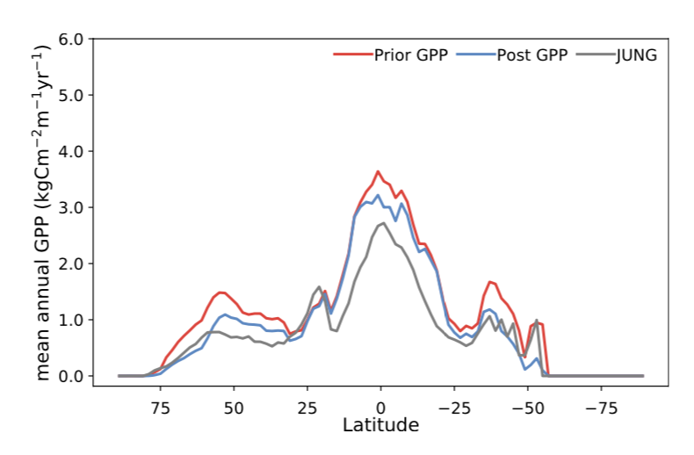
EXTRA: if you’re familiar with Python / programming
Create a latitudinal plot to compare the latitudinal distributions of GPP and SIF.
For that you will need to sum all the data for each latitude (i.e. sum all the data for each row).
The final product should look something like this (but with different data plotted):

